Slide 1

Automated student registration system
A Project
on
Globsyn Winter Training on JEE

Slide 2

Group Members
Deep Prakash Dey, Netaji Subhash Engineering College
Somnath Ghose Roy, Netaji Subhash Engineering College
Sabyasachi Pahari, Netaji Subhash Engineering College
Moumita Paul, Netaji Subhash Engineering College
Manish Nag, , Netaji Subhash Engineering College

Slide 3

Photon Finishing School
What are the features of automated student registration system ?
Photon Finishing School is an educational institute which wants to automate its student registration system. Institute offers courses on IT subjects like C, C++, and Java, JEE etc. Each course has certain duration, start date, end date, total number of students for admission.

Slide 4

Project Objective
The primary project goals consists of:
To create different accounts for counsellors and registrar.
Counsellor can register students in any of the available courses.
Registrar can add a new course.
Registrar can modify the capacity of a course.

Slide 5

Counsellor’s Profile
Add Students.
Change Password.

Slide 6
Registrar’s Profile
Add New Course.
Update Capacity.
Change Password.

Slide 7
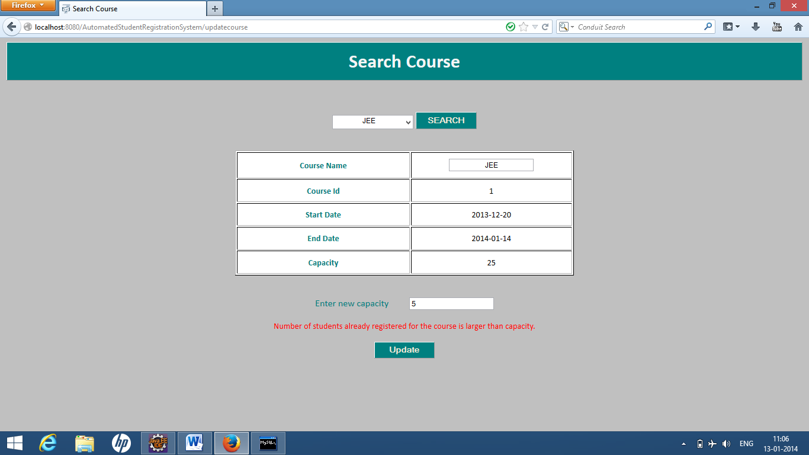
Smart Feature
While updating course capacity if the registrar enters capacity which is lesser than the number of students already registered for the course, then it shows an error message.

Slide 8
Future Scope of Improvement
As we have abided by the rules and regulations of the project abstract given by Globsyn, we can further improve on various fields like :
A registered student on successful registration can get a confirmation message through email.
There will be a provision allotted to the students where they can email the registrar or counsellor their queries which they face during their registration process.

Slide 9
Conclusion
In our software the registrar has the sole right to access and update the database.
Also the counsellor cannot delete or validate a student.
The system will limit access to authorized user only.

Slide 10
Thank you !

